Slide 1
Analysis of Food and Beverage Industry Survey Data
Using Power BI

Slide 2
OBJECTIVE
The objective is to analyze survey responses from the food and beverage industry to gain insights into consumer behavior, preferences, and perceptions. The analysis will help identify key trends, understand brand perception, and explore potential areas for improvement in product offerings and marketing strategies..

Slide 3
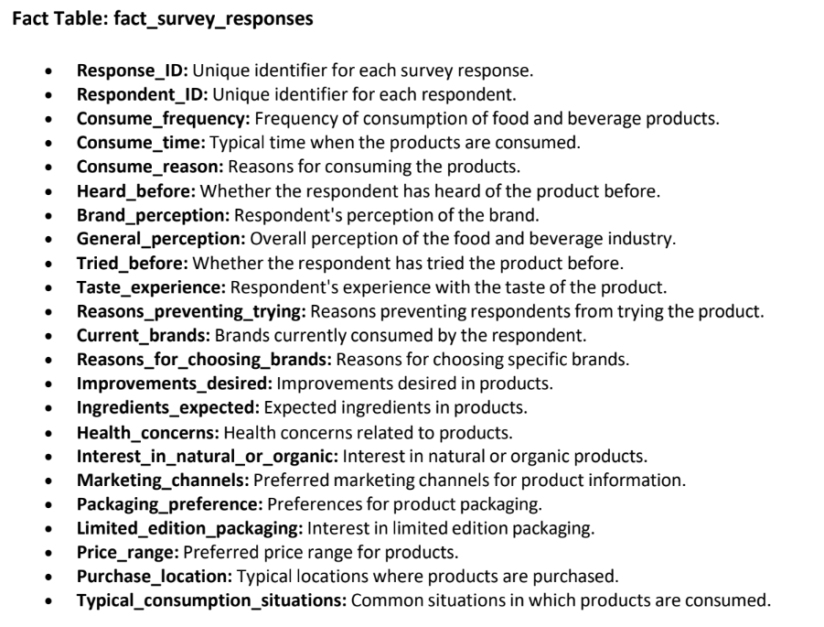
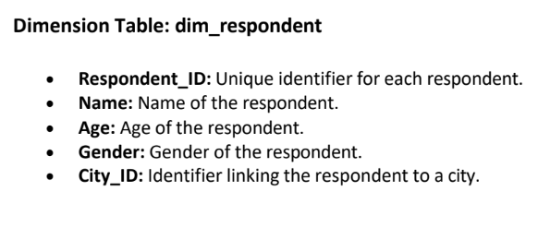
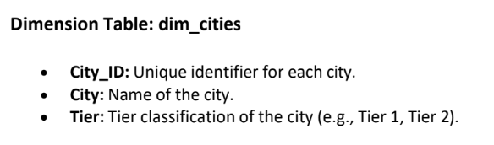
Data Description

Slide 4
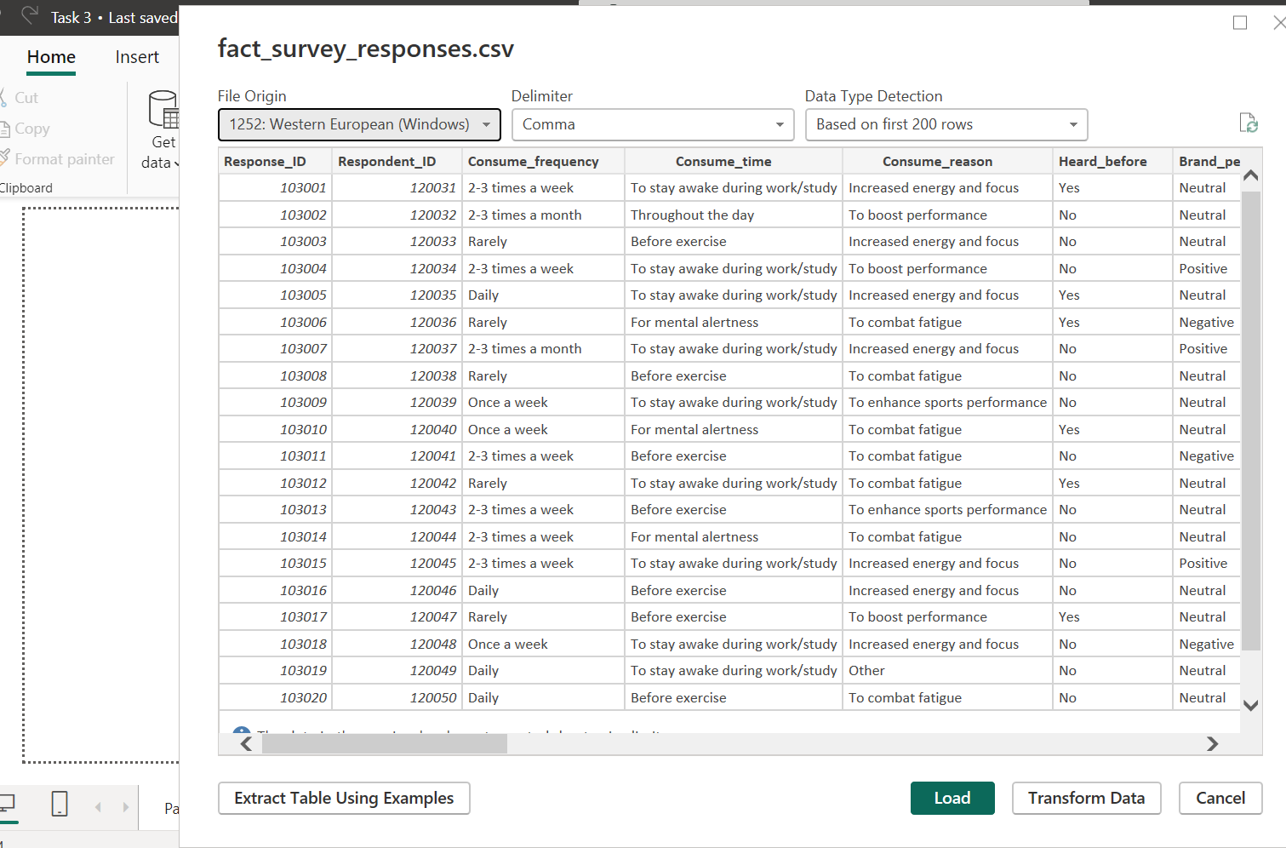
Load the data

Slide 5
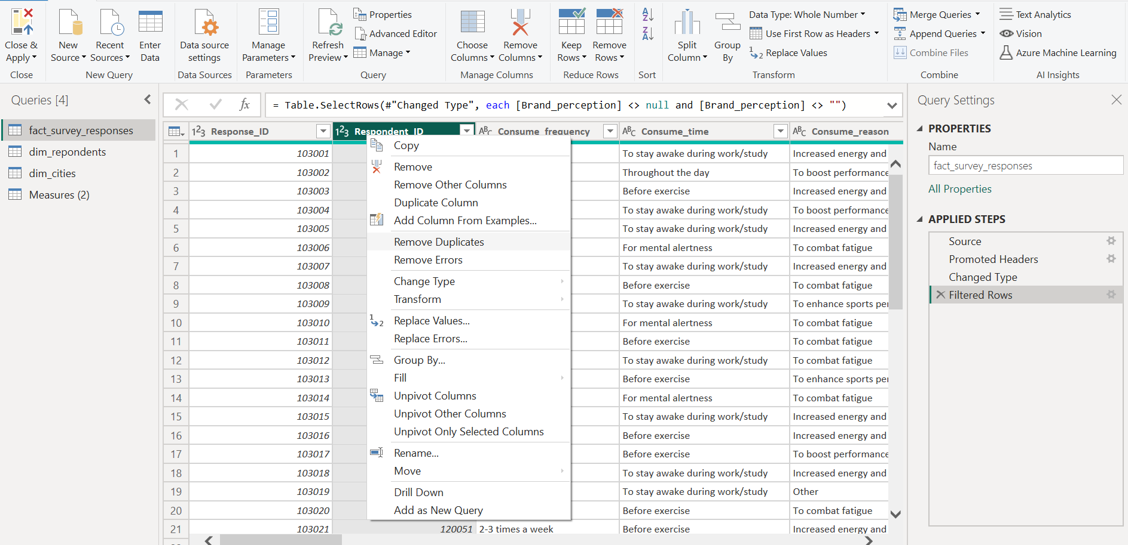
Data Cleaning

Slide 6
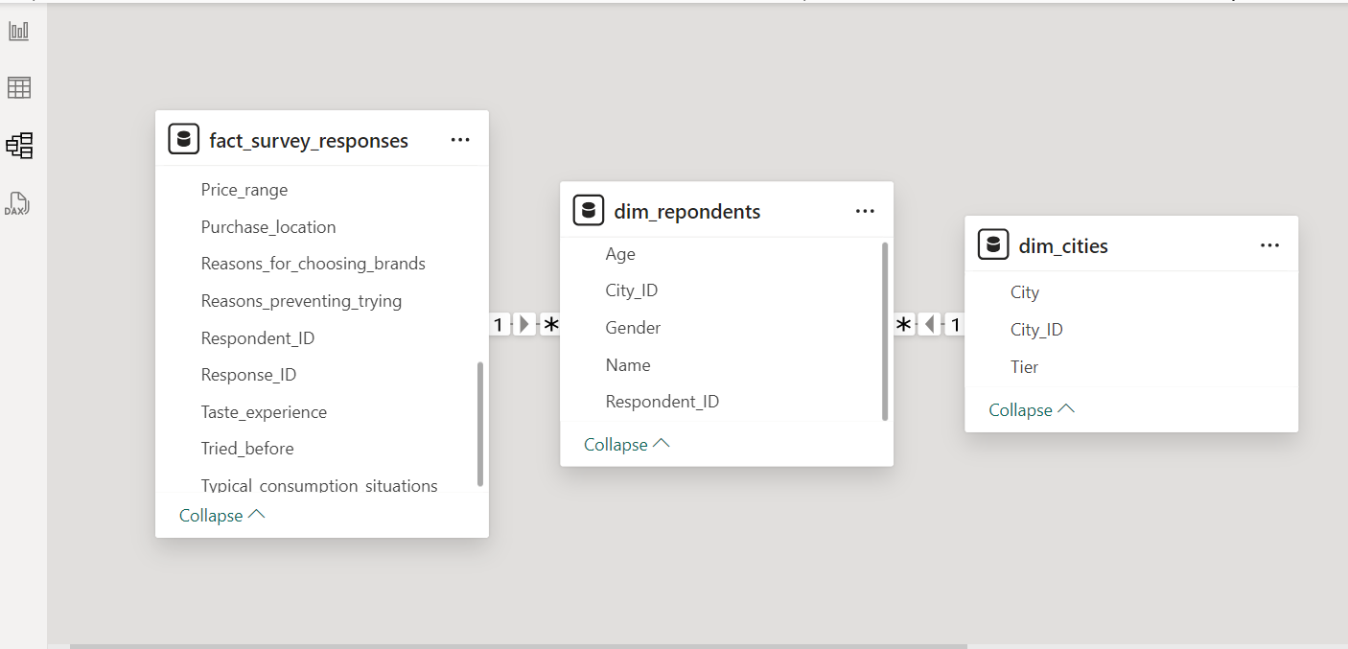
Creating Relationships

Slide 7
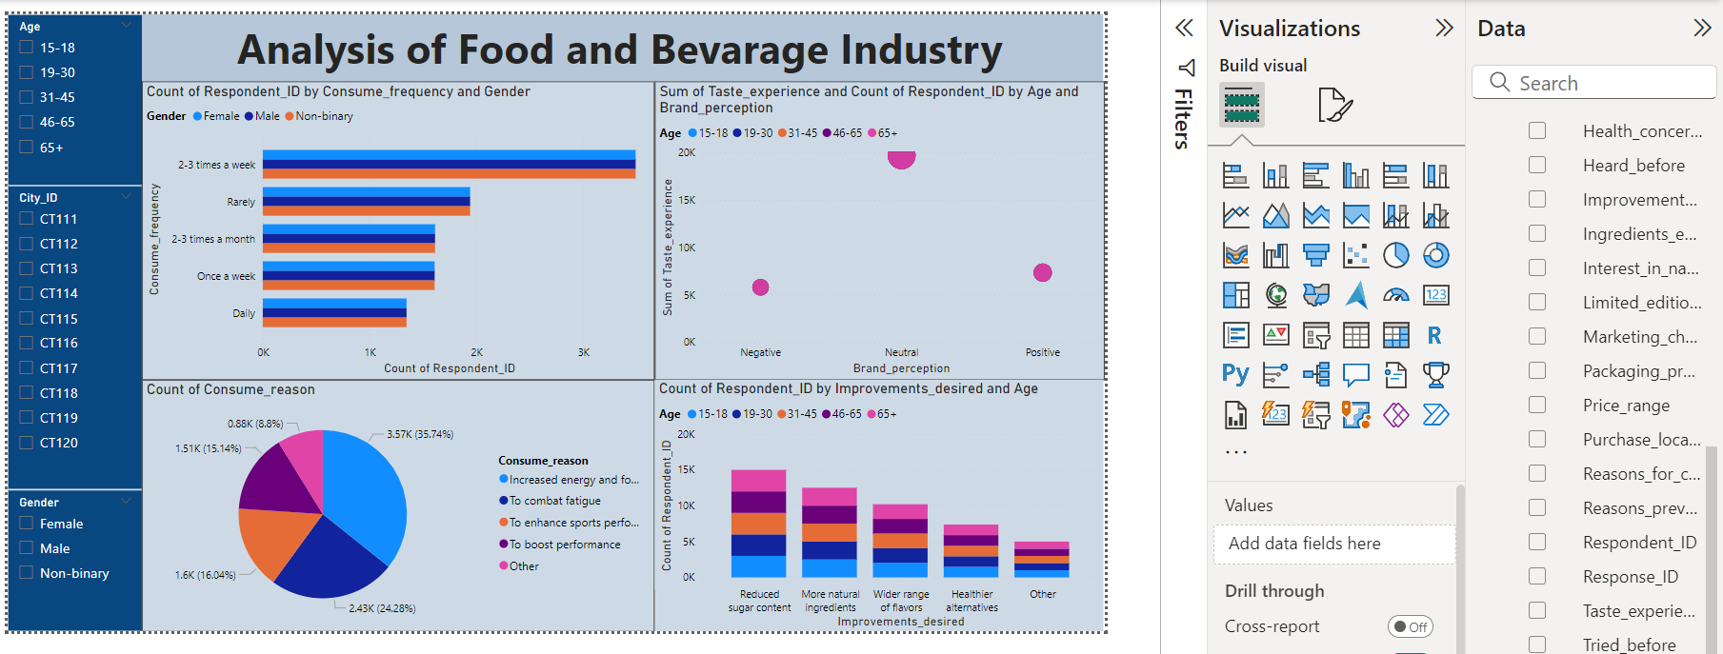
Power BI Dashboard

Slide 8
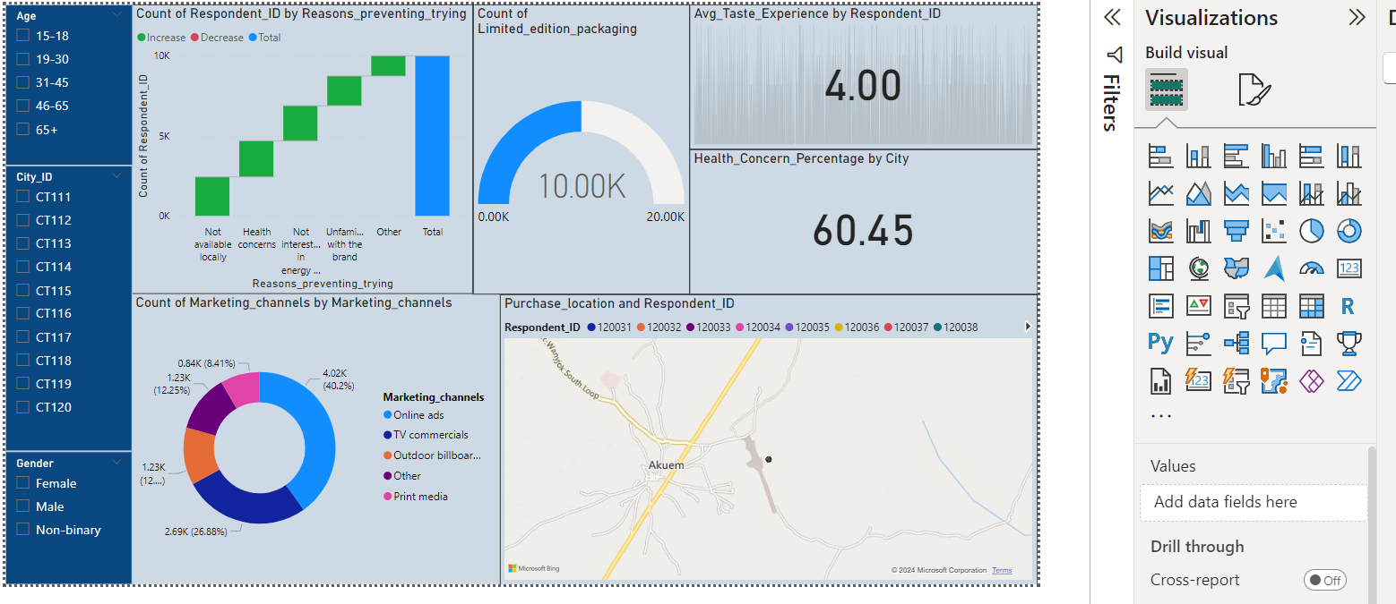
Analysis using Power BI

Slide 9
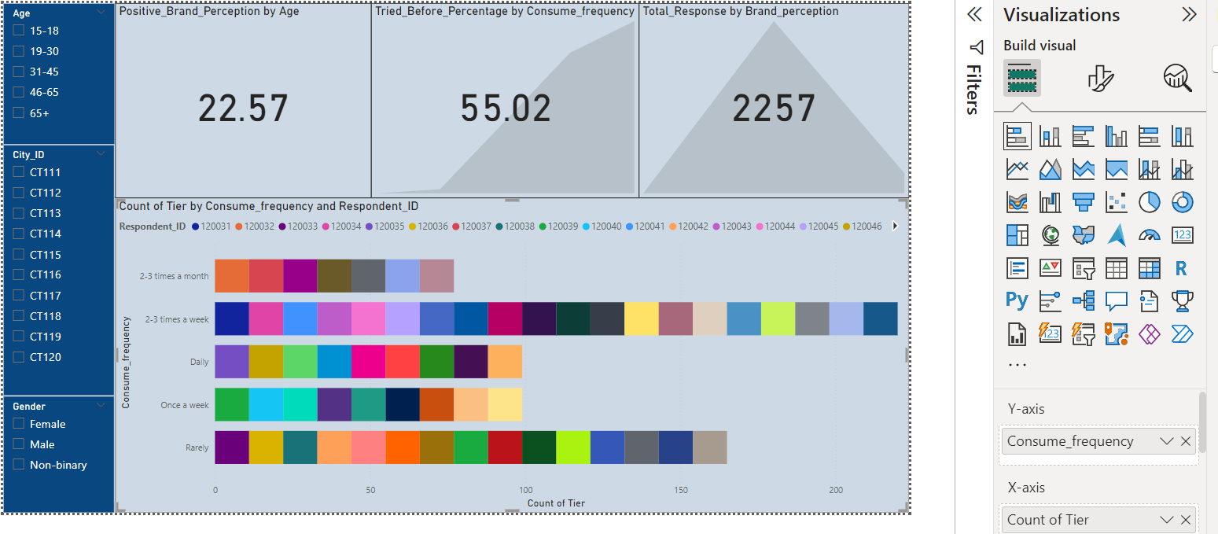
Analysis Using Power BI

Slide 10
Insights
The majority of respondents consume food and beverages 2-3 times a month. Daily consumption is relatively low.
Females and males have similar consumption patterns, with non-binary individuals consuming slightly less frequently.
Younger age groups (15-30) tend to consume more frequently than older age groups.
The pie chart reveals that the primary reason consumers use the product is for Increased Energy and Focus," accounting for 35.74%, which is significantly higher than other reasons.
Most respondents have a neutral taste experience, followed by positive and negative experiences.
A significant percentage (60.45%) of respondents are concerned about health when choosing food and beverages.
CT112 has the highest number of respondents who have tried new products due to limited edition packaging.
Online Ads are the most popular marketing channel, followed by TV Commercials and Outdoor Billboards.
The highest percentage of positive brand perception is among respondents aged 15-18, followed by the 19-30 age group.
CT115 has the highest number of respondents who have not tried new products due to unfamiliarity with the brand.

Slide 11
Recommendations
Product Development: Focus on creating healthier products with reduced sugar content and natural ingredients.
Marketing: Highlight the health benefits of products and target specific demographics based on their consumption reasons.
City-Specific Strategies: Tailor marketing and product offerings to the preferences of consumers in different cities.
Health-Focused Products: Continue to develop and promote healthier options that address consumer concerns.
Limited Edition Strategies: Use limited edition packaging and promotions to drive interest and trial.
Marketing Channel Optimization: Allocate marketing budgets effectively based on channel performance and consumer preferences.
Geographic Targeting: Tailor marketing efforts to specific regions and cities to maximize impact.
Target Youth: Continue to focus on the 15-18 age group to maintain positive brand perception.
Engage with Older Consumers: Expand marketing efforts to reach the 46-65 age group, which is a significant consumer base.
City-Specific Strategies: Tailor marketing and product offerings to the preferences of consumers in different cities.
Gender-Targeted Marketing: Consider developing marketing campaigns that resonate with specific gender groups.

Slide 12
THANK YOU

